Slide 1


Introduction to Computer Science
Reichman University
Recitation 8
Notes:
‹#›

Slide 2

Overview
Recursion
Recursion -> arrays
Memoization
Exceptions
Exceptions -> throw
Exception Handling -> try/catch/finally
Other Useful Stuff
Preconditions
Assertions
Enums

Slide 3
Question 1 - Valid Parentheses – Moed 2022A, Q2
Given a String str which consists of only the following characters: '(' ,')' ,'0'…'9' ,'-' ,'+' ,'*' ,'/' ,'%'. In other words, str contains digits, basic math operations, and rounded parentheses characters only. Write a recursive function which receives str and returns true if the str has a legal assignment of parentheses, false otherwise. A legal assignment of parentheses means that any opening parenthesis, has a closing parenthesis counterpart somewhere down the string and no closing parentheses is opened before there is a open parentheses.
String input1 = "()";
String input2 = "(";
String input3 = "((()))";
String input4 = "(()";
String input5 = ”)(";
System.out.println(isValidParentheses(input1));// true
System.out.println(isValidParentheses(input2));// false
System.out.println(isValidParentheses(input3));// true
System.out.println(isValidParentheses(input4));// false
System.out.println(isValidParentheses(input5));// false
Notes:
‹#›

Slide 4
Question 1 – Solution
public static boolean isValidParentheses (String s) {
return isValidParentheses(s, 0);
}
private static boolean isValidParentheses (String str, int counter){
if (counter < 0) {
return false;
} // if the counter is negative, return false (reached end without open)
if (str.length() == 0) {
return counter == 0; // if the string is empty, return true if the counter is 0, otherwise, false
}
// if the first character is not a parenthesis, call the function again with the rest of the string, and the same counter
if ("()".indexOf(str.charAt(0)) == -1) {
return isValidParentheses(str.substring(1), counter);
}
/* if the first character is a parenthesis, call the function again with the rest of the string
the counter will increase or decrease by 1, depending on the parenthesis
if the parenthesis is '(' the counter will increase by 1,
if the parenthesis is ')' the counter will decrease by 1.
"))("indexOf(')') will result in 0 ==> 0 - 1 = -1
"))("indexOf('(') will result in 2 ==> 2 - 1 = 1
*/
return isValidParentheses(str.substring(1), counter + ("))(".indexOf(str.charAt(0)) - 1));
}
Notes:
‹#›

Slide 5
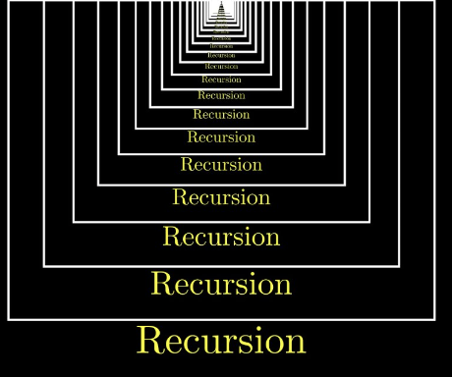
Introduction to Computer Science
Reichman University
Recitation 8
Recursion
Notes:
‹#›

Slide 6
Question 1 – mapIntoSquared
The function mapIntoSquared receives an int array, and returns a new array which holds the squared value of each element in the array.
int [] arr = {1,-5,6};
int [] arrSquared = mapIntoSquared(arr);
printArray(arrSquared); // {1,25,36}
printArray(arr); // {1,-5,6}
Implement a recursive version of this function
Notes:
‹#›

Slide 7
Question 1 – Solution
public static int[] mapIntoSquared (int[] arr){
return mapIntoSquaredHelper(arr, new int[arr.length], 0);
}
private static int [] mapIntoSquaredHelper (int[] arr, int[] result, int index){
if (index == arr.length){
return result;
}
result[index] = arr[index] * arr[index];
return mapIntoSquaredHelper(arr, result, index + 1);
}
Notes:
‹#›

Slide 8
Question 1 – Visual Example
input {1, -5, 6}
output {1, 25, 36}
User Calls function
mapIntoSquared
({1, -5, 6})
Return {1, 25, 36}
Function calls helper
mapIntoSquaredHelp
({1, -5, 6}, {0, 0, 0}, 0)
Recursive Call
Return {1, 25, 36}
mapIntoSquaredHelp
({1, -5, 6}, {1, 0, 0}, 1)
Return {1, 25, 36}
Recursive Call
mapIntoSquaredHelp
({1, -5, 6}, {1, 25, 0}, 2)
mapIntoSquaredHelp
({1, -5, 6}, {1, 25, 36}, 3)
Return {1, 25, 36}
Base Case 🡪

Slide 9
Question 2 - Recursion - Arrays
Now Let's see usage of recursion with arrays.
Usually when we want to go over the array we must use a helper function
Let’s find the maximum value within an array using recursion. You may assume that it is notempty array
maxValue({1,2,3,5,2}); // 5
Notes:
‹#›

Slide 10
Question 2 - Solution
public static int maxValue(int [] arr) {
int maxIndex = maxValueHelper(arr, 0, 0);
return arr[maxIndex];
}
private static int maxValueHelper(int [] arr, int curMaxIndex, int curIndex) {
if (curIndex == arr.length) {
return curMaxIndex;
}
if (arr[curMaxIndex] < arr[curIndex]){
return maxValueHelper(arr, curIndex, curIndex + 1);
}
return maxValueHelper(arr, curMaxIndex, curIndex + 1);
}
Notes:
‹#›

Slide 11
Question 2 – Merge arrays
mergeArrays (or merge) is a function which takes two given sorted int arrays and returns one array which contains all elements from the two arrays, sorted.
mergeArrays({1, 3, 5}, {2, 4, 6}); // {1, 2, 3, 4, 5, 6}
mergeArrays({1}, {1, 2, 3}); // {1, 1, 2, 3}
Implement a recursive version of this function
Notes:
‹#›

Slide 12
Question 2 – Solution
public static int[] mergeArrays(int[] arr1, int[] arr2) {
// create a new array to store the merged elements
int[] merged = new int[arr1.length + arr2.length];
// merge the arrays
mergeArrays(arr1, arr2, 0, 0, merged);
// return the merged array
return merged;
}
Notes:
‹#›

Slide 13
Question 2 – Solution (continue)
private static int[] mergeArrays(int[] arr1, int[] arr2, int index1, int index2, int[] merged) {
// if one of the arrays is empty, copy the rest of the other array into merged
if (index1 >= arr1.length) {
copyArray(arr2, merged, index2, index1 + index2);
return merged;
}
if (index2 >= arr2.length) {
copyArray(arr1, merged, index1, index1 + index2);
return merged;
}
// add the smaller element to the merged array
if (arr1[index1] < arr2[index2]) {
merged[index1 + index2] = arr1[index1];
index1++;
} else {
merged[index1 + index2] = arr2[index2];
index2++;
}
// recursively merge the rest of the arrays
return mergeArrays(arr1, arr2, index1, index2, merged);
}
Notes:
‹#›
Index1 + index2 = index3 (of merged array)

Slide 14
Question 2 – Solution (continue)
private static void copyArray(int[] arr1, int[] arr2, int index1, int index2) {
// if finished copying, return
if (index1 == arr1.length || index2 == arr2.length) {
return;
}
// copy the value at the current index
arr2[index2] = arr1[index1];
// recursively copy the rest of the array
copyArray(arr1, arr2, index1 + 1, index2 + 1);
}
Notes:
‹#›

Slide 15
Question 2 – Visual Example
User Calls function
Input
{1, 7, 9}, {2, 8}
mergeArrays
{1, 7, 9}, {2, 8}
Return
{1, 2, 7, 8, 9}
…
mergeArrays
{1, 7, 9}, {2, 8}, 0, 0,
{0, 0, 0, 0, 0}
Function calls helper
…
mergeArrays
{1, 7, 9}, {2, 8}, 1, 0,
{1, 0, 0, 0, 0}
…
mergeArrays
{1, 7, 9}, {2, 8}, 1, 1,
{1, 2, 0, 0, 0}
…
mergeArrays
{1, 7, 9}, {2, 8}, 2, 1,
{1, 2, 7, 0, 0}
Return
{1, 2, 7, 8, 9}
mergeArrays
{1, 7, 9}, {2, 8}, 2, 2,
{1, 2, 7, 8, 0}
Return
{1, 2, 7, 8, 9}
mergeArrays
{1, 7, 9}, {2, 8}, 2, 2,
{1, 2, 7, 8, 9}

Slide 16
Question 3 – filterByLength
The function filterByLength receives a String array, and a non negative int ‘minLen’ which represent a certain length of a String, and returns a new String array which holds the all the strings which has length equal or bigger than ‘minLen’.
String [] arr = {“hello”,”hi”,”word”};
String [] arrFiltered = filterByLength(arr,4);
printArray(arrFiltered); // {“hello”,”word”}
printArray(arr); // {“hello”,”hi”,”word”}
Implement a recursive version of this function
Notes:
‹#›

Slide 17
Question 3 – Solution
public static String[] filterByLength(String[] arr, int minLen) {
int count = filterByLengthCounter(arr, minLen, 0);
String[] filteredArray = new String[count];
filteredArray = filterByLengthHelper(arr, filteredArray, minLen, 0, 0);
return filteredArray;
}
private static int filterByLengthCounter(String[] arr, int minLen, int index) {
if (arr.length == index) {
return 0;
}
int isInLength = (arr[index].length() >= minLen) ? 1 : 0;
return isInLength + filterByLengthCounter(arr, minLen, index + 1);
}
Notes:
‹#›

Slide 18
Question 3– Solution (continued)
private static String[] filterByLengthHelper(String[] arr, String[] filtered,
int minLen, int originalArrIndex, int newArrIndex) {
if (arr.length == originalArrIndex) {
return filtered;
}
if (arr[originalArrIndex].length() >= minLen){
filtered[newArrIndex] = arr[originalArrIndex];
newArrIndex++;
}
return filterByLengthHelper(arr, filtered, minLen, originalArrIndex + 1, newArrIndex);
}
Notes:
‹#›

Slide 19
Question 3 – Visual Example
Function calls helper
User Calls function
Function returns
Input
({“ab”, “c”, “de”}, 2)
Output
{“ab”, “de”}
filterByLength
({“ab”, “c”, “de”}, 2)
1 + 1
filterByLengthHelper
({“ab”, “c”, “de”}, {“”, “”}, 2, 0, 0
…
filterByLengthCounter
({“ab”, “c”, “de”}, 2, 0)
0 + 1
filterByLengthCounter
({“ab”, “c”, “de”}, 2, 1)
Recursive call
filterByLengthHelper
({“ab”, “c”, “de”}, {“ab”, “”}, 2, 1, 1
…
Recursive call
1 + 0
filterByLengthCounter
({“ab”, “c”, “de”}, 2, 2)
Recursive call
0
Recursive call
filterByLengthHelper
({“ab”, “c”, “de”}, {“ab”, “”}, 2, 2, 1
{“ab”, “de”}
filterByLengthCounter
({“ab”, “c”, “de”}, 2, 3)
Base
case
Base
case
filterByLengthHelper
({“ab”, “c”, “de”}, {“ab”, “de”}, 2, 3, 2

Slide 20

Memoization
Introduction to Computer Science
Reichman University
Recitation 8
Notes:
‹#›

Slide 21
Reminder – Recitation 7, Question 2
Let's reconsider the following code:
Natural questions to ask are:
How many recursive calls are made to calculate one value of n ?
Aren’t we calculating the same values repeatedly?
public static int fibo2(int n){
if (n == 0 || n == 1){
return n;
}
return fibo2(n - 1) + fibo2(n - 2);
}
Notes:
‹#›

Slide 22
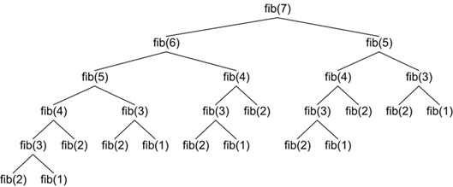

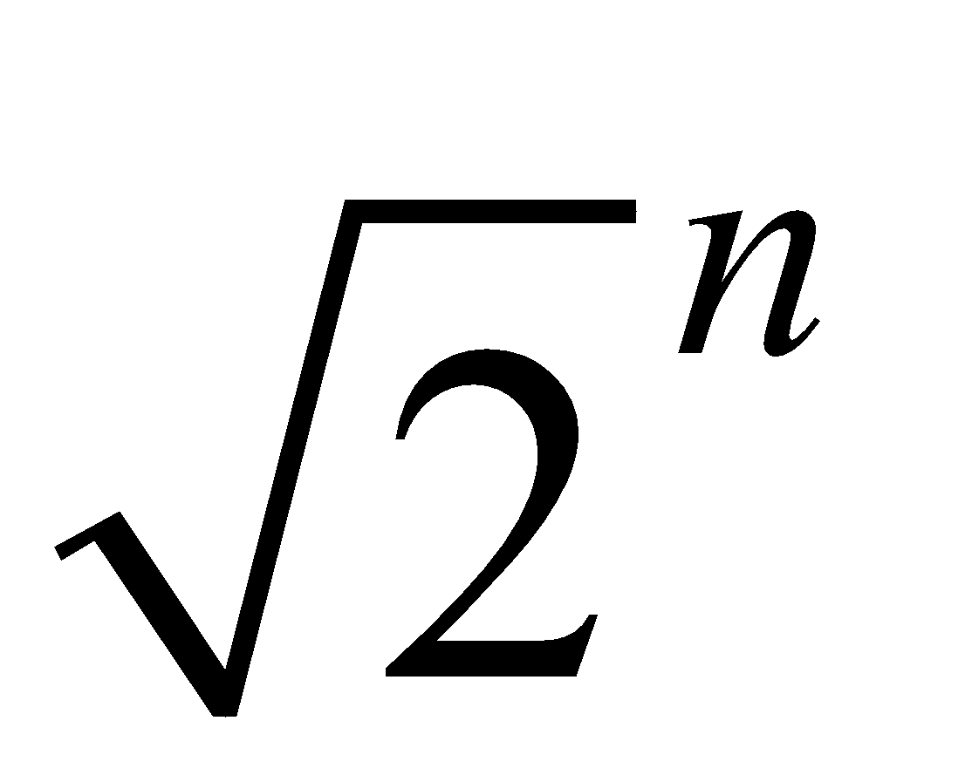
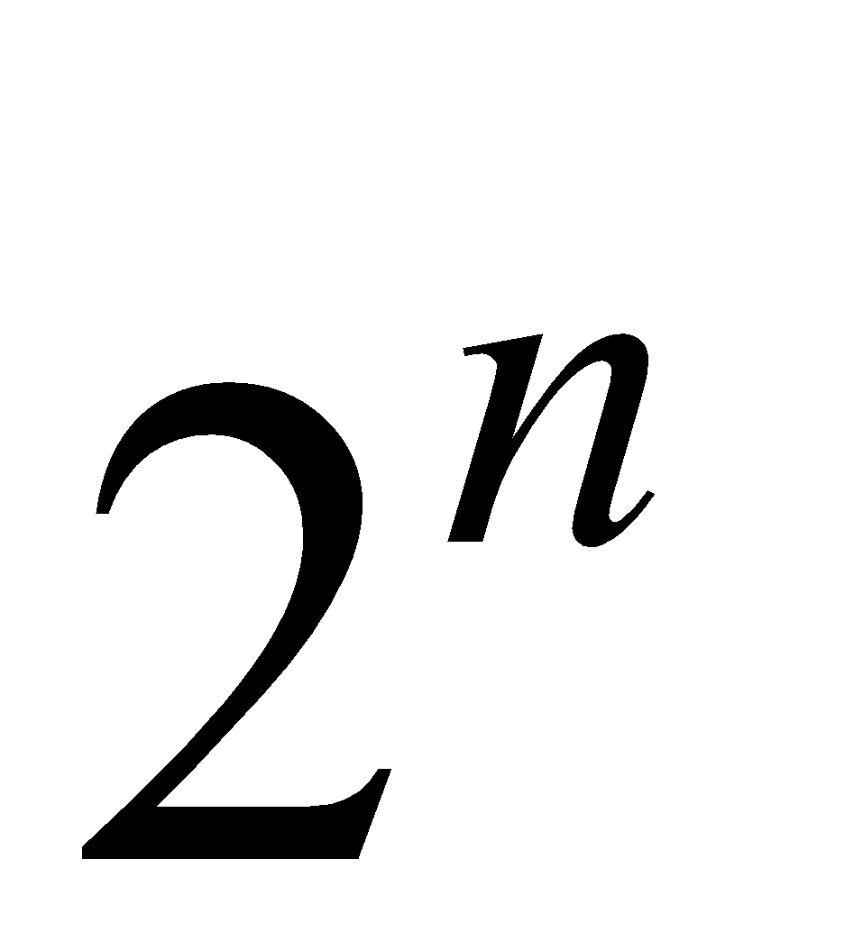
Fibonacci
Example for n = 7:
Mathematical analysis shows that for any n, the total number of recursive calls is somewhere between and .
For n = 100, we will need more than 10,000,000,000,000,000 recursive calls.
Let's see how we can increase the efficiency.
Notes:
‹#›

Slide 23
Fibonacci – The Memoization Method
Notice that even though we have many recursive calls, a great fraction of them is identical.
Calculating fib(3) so many times is redundant.
If we could reuse past calculations we would lower the number of recursive calls.
Notes:
‹#›

Slide 24
Fibonacci – The Memoization Method
A memoization table does exactly that.
In our case, we will use an array to hold all the Fibonacci numbers which were calculated.
Every time a new value is calculated we will keep the value inside the memoization table.
Every time a recursive call is made we will check if that value was already calculated.
If it was, we can simply return the value present in the memoization table.
Otherwise, calculate as normal.
memoization
memoization
memoization
memoization
Notes:
‹#›

Slide 25
Question 4 - Memoization - Solution
public static long fibonacciMemoization(int n){
return fibonacciMemoization(n, new long[n + 1]);
}
public static long fibonacciMemoization(int n, long[] fib) {
// if n is 0 or 1, return n
if (n == 0 || n == 1) {
return n;
}
// if the Fibonacci number has already been calculated, return it
if (fib[n] != 0) {
return fib[n];
}
// the Fibonacci number at index n is the sum of the previous two numbers
fib[n] = fibonacciMemoization(n - 1, fib) + fibonacciMemoization(n - 2, fib);
return fib[n];
}

Slide 26
Question 4 – Visual Example
Input: 4
fibonacciMemoization(4)
Output: 3
1 + 2
Fibonacci
Memoization
(4, fib)
1 + 1
1
Fibonacci
Memoization
(3, fib)
Fibonacci
Memoization
(2, fib)
0 + 1
1
Fibonacci
Memoization
(2, fib)
Fibonacci
Memoization
(1,fib)
1
0
Fibonacci
Memoization
(1,fib)
Fibonacci
Memoization
(0, fib)
fib={0, 1, }
1,
2,
3

Slide 27
Question 5 - Memoization – maxSubArray
The function maxSubArray receives an int array, and returns an int.
The array holds both negative and positive, unsorted.
The function calculates the largest (in terms of value) sum of continuous sub array and return its value.
Examples:
maxSubArray({1,2,3});
// value : 6, subarray:{1,2,3}
maxSubArray({-2, 1, -3, 4, -1, 2, 1, -5, 4});
// value : 6, subarray:{4,-1,2,1}
maxSubArray({5, -1, -2, 7, -6, 3, -2, -10});
// value : 9, subarray:{5,-1,-2,7}
maxSubArray({3, 1, -7, -6, 3, -2, 2, 1, -3, 14, 5});
// value : 20, subarray: {2, 1, -3, 14, 5}
Build the function maxSubArray using recursion and memoization
Notes:
‹#›

Slide 28
Question 5 - Solution
public static int maxSubArray(int[] nums) {
// create new array for memo'
int [] maxSub = new int [nums.length];
// create fill the data with Integer.MIN_VALUE to not tamper with calculation
fillArray(maxSub, 0, Integer.MIN_VALUE);
// base case
maxSub[0] = nums[0];
// fill rest of memo array
maxSubArrayHelper(nums, maxSub, 1);
// find max in the memo array
return findMax(maxSub);
}
private static void maxSubArrayHelper(int[] nums, int [] maxSub, int index) {
// if the finished running, return
if (nums.length == index) {
return;
}
// calculating according to formula
maxSub[index] = Math.max(maxSub[index - 1] + nums[index], nums[index]);
// recursively calculating the rest of the array
maxSubArrayHelper(nums, maxSub, index + 1);
}

Slide 29
Question 5 – Solution (continue)
private static void fillArray(int[] arr, int index, int value) {
// if the finished running, return
if (index == arr.length) {
return;
}
// set the value at the current index
arr[index] = value;
// recursively fill the rest of the array
fillArray(arr, index + 1, value);
}
private static int findMax(int [] arr) {
int maxIndex = findMaxHelper(arr, 0, 0);
return arr[maxIndex];
}
private static int findMaxHelper(int [] arr, int curMaxIndex, int curIndex) {
if (curIndex == arr.length) {
return curMaxIndex;
}
if (arr[curMaxIndex] < arr[curIndex]){
return findMaxHelper(arr, curIndex, curIndex + 1);
}
return findMaxHelper(arr, curMaxIndex, curIndex + 1);
}

Slide 30
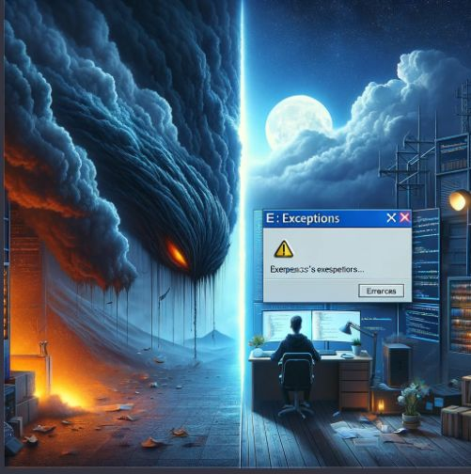
Exceptions
Recitation 8
Notes:
‹#›

Slide 31
Runtime Errors
An event, which occurs during the execution of a program, that disrupts the normal flow of the program's instructions:
Trying to read a file that doesn’t exist
Trying to divide an integer by zero
Calling a method with improper arguments. Say, calling the CharAt(int i) method of a String object with a negative integer.
Etc.
In these cases, the instruction would fail. We say that a run-time error had occurred.
Notes:
‹#›

Slide 32
Exceptions
In Java, run-time errors are indicated by exceptions.
If a method wants to signal that something went wrong during its execution it throws an exception.
Throwing an exception involves:
creating an exception object that encloses information about the problem that occurred
use of the statement throw to notify about the exception
Example in String class
public char charAt(int i){
if (i < 0 || i >= this.length()){
throw new IndexOutOfBoundsException(i + “ is out of bounds”);
}
}
Notes:
‹#›

Slide 33
Examples of Exception Types
Several types of exceptions are defined in Java:
IllegalArgumentException - passing an illegal argument to a method. Example: Math.pow(0,”0”);
ArithmeticException – Example: division by zero.
NullPointerException - trying to refer to an object through a variable whose value is null
And more.
You can define more on your own.
Notes:
‹#›

Slide 34
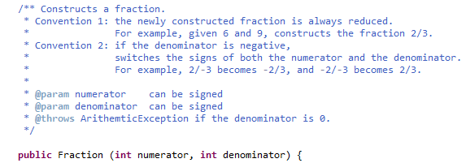
Documenting Exceptions
JavaDoc helps us document possible exceptions via the @throws tag.
Notes:
‹#›

Slide 35
Handling Exceptions
As you already (painfully) know, runtime errors crash your programs.
However, this is not always preferable.
For example, imagine we are trying to read an integer through the standard input.
When a user enters “five” or “5,” instead of “5”, our program will crash.
Think about more complicated programs (Flight Control, Security Systems, etc.).
It doesn’t seem reasonable for a program to crash when a user makes a typo.
Notes:
‹#›

Slide 36
Try … Catch
The idea is to try and execute some statement.
If whatever you tried succeeded, all is well. The program will continue, and the catch statement is ignored.
If an exception is thrown by any of the statements within the try block, the rest of the statements are skipped, and the corresponding catch block is executed.
Every catch clause has an associated exception type.
When an exception occurs, processing continues at the first catch clause matching the exception type.
try {
\\something
} catch (ExceptionType e){
\\handle it
}
Notes:
‹#›

Slide 37
Try … Catch - Examples
public class ExceptionExamples {
/**
* Tries to read an integer through the standard input
* If an illegal argument is entered, returns 0
*/
public static int readInt() {
In in = new In();
int ans = 0;
StdOut.println("Please enter a number.");
try {
String s = in.readString();
ans = Integer.parseInt(s);
} catch (NumberFormatException e) {
ans = 0;
}
return ans;
}
public class ExceptionExamples {
/**
* Tries to read an integer through the standard input
* Keeps prompting the user to enter a valid argument
*/
public static int readInt2() {
int ans = 0;
boolean legal = false;
StdOut.println("Please enter a number.");
In in = new In ();
while (!legal) {
try {
String s = in.readString();
ans = Integer.parseInt(s);
legal = true;
} catch (NumberFormatException e) {
StdOut.println("Invalid argument, try again.");
}
}
return ans;
}
Notes:
‹#›

Slide 38
Try … Catch … Finally
After the try-catch structure, there's the finally block. The finally block contains code that will be executed whether an exception is thrown or not.
It's useful for cleanup operations, such as closing a file
It’s optional
try {
\\ do something
} catch (ExceptionType e){
\\ handle it
} finally {
\\ do something regardless of whether an
\\ exception occurred or not
}
Notes:
‹#›

Slide 39
Try … Catch … Finally - Example
public class ExceptionExamples {
/**
* Tries to read an integer through the standard input
* If an illegal argument is entered, returns 0
*/
public static int readInt3() {
int ans = 0;
StdOut.println("Please enter a number.");
In in = new In();
try {
String s = in.readString();
ans = Integer.parseInt(s);
} catch (NumberFormatException e) {
ans = 0;
} finally {
// will execute always.
return ans;
}
}
Notes:
‹#›

Slide 40

Pre Conditions
Recitation 8
Notes:
‹#›

Slide 41
Pre-Conditions
In Java, preconditions are conditions or constraints that must be true before a method is executed.
They ensure that the method can perform its task successfully.
If a method detects that its preconditions are violated, it should indicate this by throwing an exception.
/**
* Takes an integer from the user and returns its inverse.
* Uses preconditions to enforce the user to enter a valid argument (non zero
* integer).
*/
public static double inverse(int number) {
// Enforce specified precondition.
if (number == 0) {
throw new ArithmeticException("Zero doesn’t have an inverse.");
}
double ans = 0;
ans = 1 / number;
return ans;
}
Notes:
‹#›

Slide 42

Assertions
Recitation 8
Notes:
‹#›

Slide 43
Assertions
Assertions are used to validate assumptions or expectations about the state of the program during runtime.
They help ensure that certain conditions or constraints are met as the program executes.
Assertions, when used effectively, contribute to the reliability and maintainability of the code by catching potential errors and validating critical assumptions about the program's state.
Notes:
‹#›

Slide 44
Assertions
In Java, assertions use the assert keyword followed by a boolean expression.
If the expression evaluates to false, an AssertionError is thrown.
Assertions are disabled by default.
To enable them, run the JVM with the -ea (or -enableassertions) option.
”java –ea YourClassName”.
Syntax:
assert booleanExpression : “Optional message if assertion fails”
Notes:
‹#›

Slide 45
Assertions - Example
/**
* Takes a positive integer from the user and returns its factorial
* Uses assertions to enforce the user to enter a valid positive argument.
*/
public static int factorial(int number) {
if (number < 0) {
throw new ArithmeticException("factorial should receive non negative number");
}
int ans = 1;
for (int i = 1; i <= number; i++) {
ans *= i;
assert ans > 0: "overflow has been occurred";
}
return ans;
}
Notes:
‹#›

Slide 46
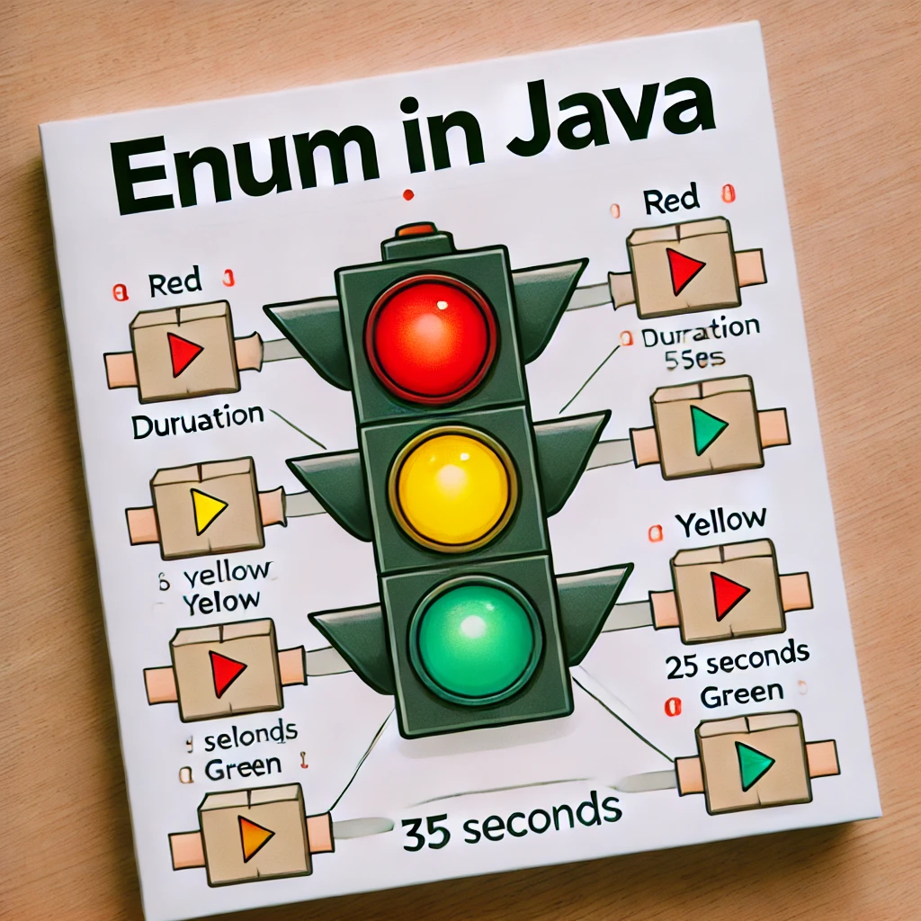
Enums
Recitation 8
Notes:
‹#›

Slide 47
What is Enum?
Up to this point we have worked with primitive types, arrays, and Strings. However, the world is very complex, and not all thing can be defined into those types.
Most of them can be represented by some combination of those types (this will be covered next week) however, there are some cases that when we want to define a type for a fixed number of values. For that we can use enum.
Enum (short for enumeration) is a special data type in Java used to define a set of constants.
These constants are often related and belong to the same category.
Some examples:
Days of the week (Sunday, Monday etc.)
Months of the year (January, February etc.)
Suit of cards (Heart, Daimond etc.)
Value of cards (2, 3, …., 10, Jack, Queen, King, Ace)
Chess pieces (Pawn, Rook, etc.)
(Many more)
Notes:
‹#›

Slide 48
Why should we type them and not use existing types?
Type safety - It will limit the usage of user to certain values, keeping to those values can prevent bugs and make the code more reliable.
Readability – will make thing much more readable.
Prevent Magic values – As you recall magic numbers is the concept of assigning fixed values of numbers/strings without context. Those values are considered bad practice. Those give much needed context
Reusable - can be used in other places of code.
Iteration – all enums come with the built-in method {enumName}.values() which returns an array of all enum values which in fact allows you to iterate over them.
Many more…
Notes:
‹#›

Slide 49
Enums Example
Traffic lights usually have 3 colors
Red -> The cars should stop driving
Yellow -> The cars should slow down
Green -> The cars should go
They move in cycle: Red -> Yellow -> Green -> Red
Notes:
‹#›
If they ask about red/yellow say we wanted to simplify but it can be done easily

Slide 50
Non-Enum Example
public static int final RED = 0;
public static int final GREEN = 1;
public static int final YELLOW = 2;
public static String[] lightNames = [“RED”, “GREEN”, “YELLOW”];
public int getNextLight (int light) {
int nextLight = RED;
switch (light) {
case RED:
nextLight = GREEN;
break;
case YELLOW:
nextLight = RED;
break;
case GREEN:
nextLight = YELLOW;
break;
}
System.out.println(“Current light: " + lightNames[light] + “Next light:" + lightNames[nextLight]);
return nextLight;
}
Notes:
‹#›

Slide 51
Enums Example
public enum TrafficLightEnum {
RED,
YELLOW,
GREEN
}
Notes:
‹#›

Slide 52
Enums Example
public TrafficLightEnum getNextLight (TrafficLightEnum light) {
TrafficLightEnum nextLight = TrafficLightEnum.RED;
switch (light) {
case TrafficLightEnum.RED:
nextLight = TrafficLightEnum.GREEN;
break;
case TrafficLightEnum.YELLOW:
nextLight = TrafficLightEnum.RED;
break;
case TrafficLightEnum.GREEN:
nextLight = TrafficLightEnum.YELLOW;
break;
}
System.out.println(“Current light: " + light + “ Next light: " + nextLight);
return nextLight;
}
Notes:
‹#›

Slide 53
Enums Example
public CarActionEnum decide(TrafficLightEnum light) {
CarActionEnum action = CarActionEnum.STOP;
switch (light) {
case TrafficLightEnum.RED:
action = CarActionEnum.STOP;
break;
case TrafficLightEnum.YELLOW:
action = CarActionEnum.SLOW_DOWN;
break;
case TrafficLightEnum.GREEN:
action = CarActionEnum.GO;
break;
default:
action = CarActionEnum.STOP;
break;
}
return action;
}
public static void iterateEnum() {
TrafficLightEnum[] lights = TrafficLightEnum.values();
for (int i = 0; i < lights.length; i++) {
System.out.println(lights[i]);
}
}
public enum CarActionEnum {
SLOW_DOWN,
STOP,
GO,
}
Notes:
‹#›

